Slide 1


Hii,
Iam Siddhika
Welcome to Power BI Series
Part -77

Slide 2



I’m very excited to dive into this with you all!
Are you ready to enhance your data visualization skills?
We focus only on the most used and important Visuals
Today Content
VISUALIZING DATA
BOOKMARKS
CREATING BOOKMARKS WITH EXAMPLE.

Slide 3


BOOKMARKS
check next slide ..
Bookmarks in Power BI allow you to capture and save the current state of a report page, including filters, slicers, and visuals.
This feature helps create interactive and dynamic reports.
Key Features of Bookmarks:
Save States: Capture the current view of a report page.
Create Narratives: Tell a story with your data by navigating through different states.
User Interaction: Allow users to switch between different views of the report easily.
Reset Filters: Create a bookmark to reset all filters and slicers.

Slide 4

When to Use Bookmarks:
Interactive Presentations: Show different scenarios or insights during a presentation.
Guided Analysis: Guide users through a series of steps or insights.
Quick Navigation: Jump to specific views or sections of the report.
Try it out..

Slide 5
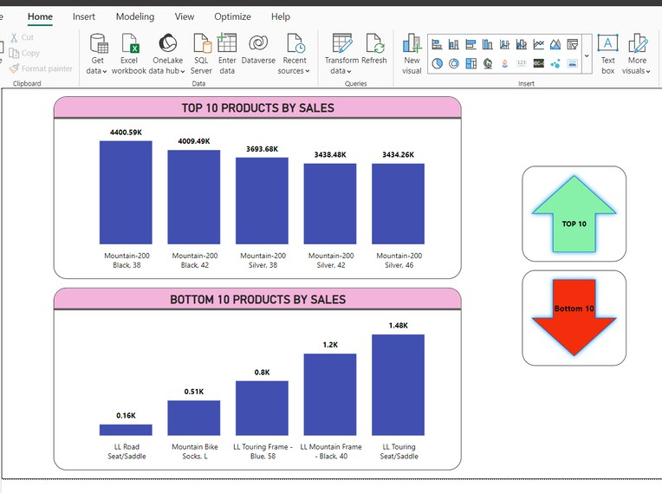
CREATING A BOOKMARK WITH EXAMPLE
DO along with me guys with this example.
Lets Create bookmarks to highlight "Top 10 Products" and "Bottom 10 Products" and add navigation buttons to switch between these views.
I want see Top 10 products by clicking on top 10 button and bottom 10 by clicking on bottom 10 button.

Slide 6
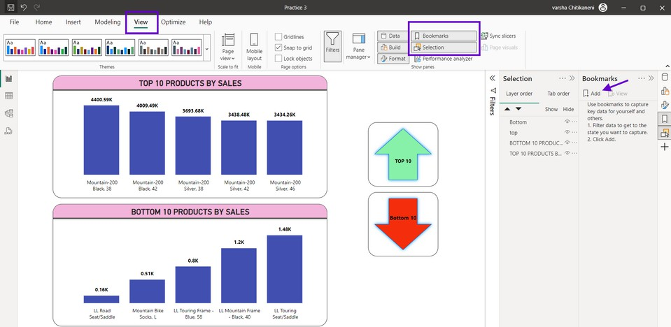

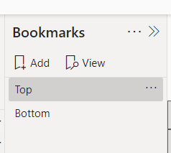

-> Go to view tab, select Bookmark and also Selection tab to select the views as per our need to the bookmark.
Try it..
--> Next bookmark ADD
I have added 2 by clicking on

Slide 7
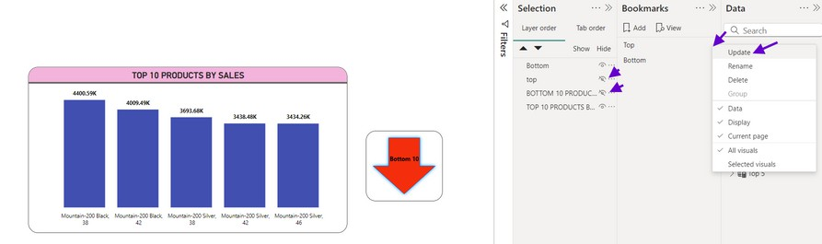
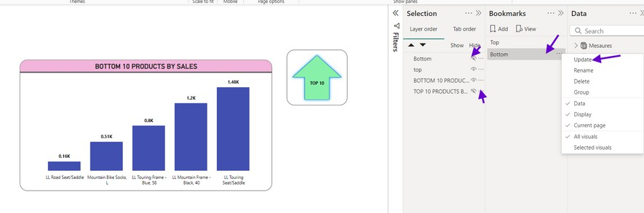
-->hide the visuals in the selection which we don’t want in the Top bookmark view.and right click on Top bookmark , next click on update to update the Top 10 products bookmark
next check
how we can
go to that
bookmarks ..
-->similarly hide the visuals in the selection which we don’t want in the Bottom bookmark view.and right click on Bottom bookmark , next click on update to update the Bottom 10 products bookmark

Slide 8
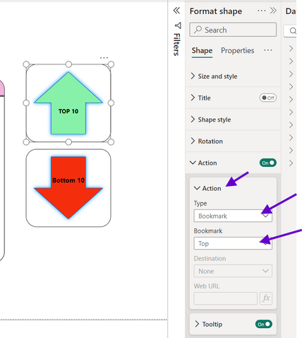
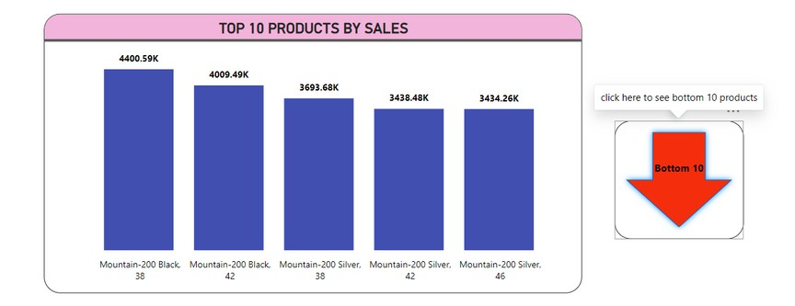
select the TOP 10 button , go to format pane->go to action-
Try it ..
>select
>select
top view
TYPE as Bookmark- bookmark we created
similarly do for the Bottom 10
button.
Our bookmarks are ready to use....

Slide 9


Thank you for joining me today to learn about Part -77 of Power BI!
Remember, Effective data visualization is crucial for turning data into meaningful insights and compelling narratives with Power BI.
Stay tuned for more insights and tips on Power BI in our next Series.
Follow

